Slide 1
Creating an Employee Performance Scorecard in Excel
Student Name: A. Saravanan
Register Number :312211672
Department:BCOM General A
College:thrithangal nadhar college

Slide 2
AGENDA
1.problem statement 2.project overview 3.end users 4.our solution and proposition 5.data description 6.modelling approach 7.result and discussion 8.conclusion

Slide 3
Problem statement
Evaluating Employee Performance Effectively” Description: Explain the challenges of manual performance evaluation and the need for a data-driven approach.

Slide 4
Project overview
Employee Performance Scorecard Project” Description: Outline the project’s objectives, scope, and timeline

Slide 5
End users
Stakeholders and End Users” Description: Identify the stakeholders and end users of the scorecard, such as HR, management, and employees.

Slide 6
Our solution and proposition
Automated Performance Scorecard with Excel” Description: Explain how an Excel-based scorecard can streamline performance evaluation and provide actionable insights

Slide 7
Data description
:“Performance Data Overview” Description: Describe the data used for the scorecard, including: -Data sources (HR systems, performance reviews, etc.) Variables (employee ID, job title, performance metrics, etc.) Data quality and preprocessing steps

Slide 8
Modelling approach
Designing the Performance Scorecard” Description: Outline the modeling approach, including: Scorecard framework and structure - Metric selection and weighting – Data visualization and formatting

Slide 9
Result and discussion
FITNESS PROGRESS CHART
Date | Weight | Chest | Waist | Hips | Forearm | Estimated Lean Body | Estimated Body Fat | Estimated Body Fat %
5/3/2013 | 140 | 32 | 31 | 40 | 11.5 | 103.8 | 36.2 | 0.259
5/11/2013 | 140 | 32 | 31 | 39.5 | 11.5 | 103.9 | 36.1 | 0.258
5/19/2013 | 139 | 32 | 31 | 39.5 | 11.5 | 103.2 | 35.8 | 0.258
5/26/2013 | 138 | 31 | 30 | 39 | 11 | 103.4 | 35.6 | 0.256
6/1/2013 | 138 | 31 | 30 | 39 | 11 | 103.4 | 35.6 | 0.256

Slide 10
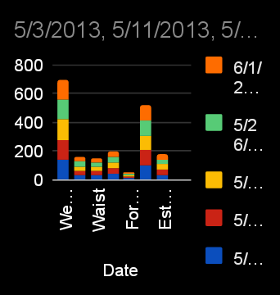
Par chart

Slide 11
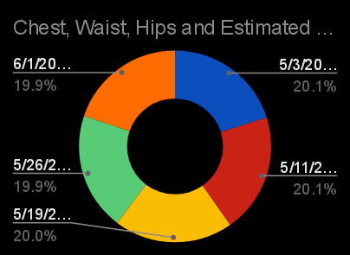
Pie chart

Slide 12
conclusion
"Conclusion and Recommendations"Description: Summarize key findings, implications, and recommendations for improving employee performance management practices.

